Slide 1
A26 (Single) - 50M
Process
Process
PDAF(INF)
PDAF(MAC)
DF

Slide 2
A26 (Single) - 50M
Process PDAF(INF)

Slide 3
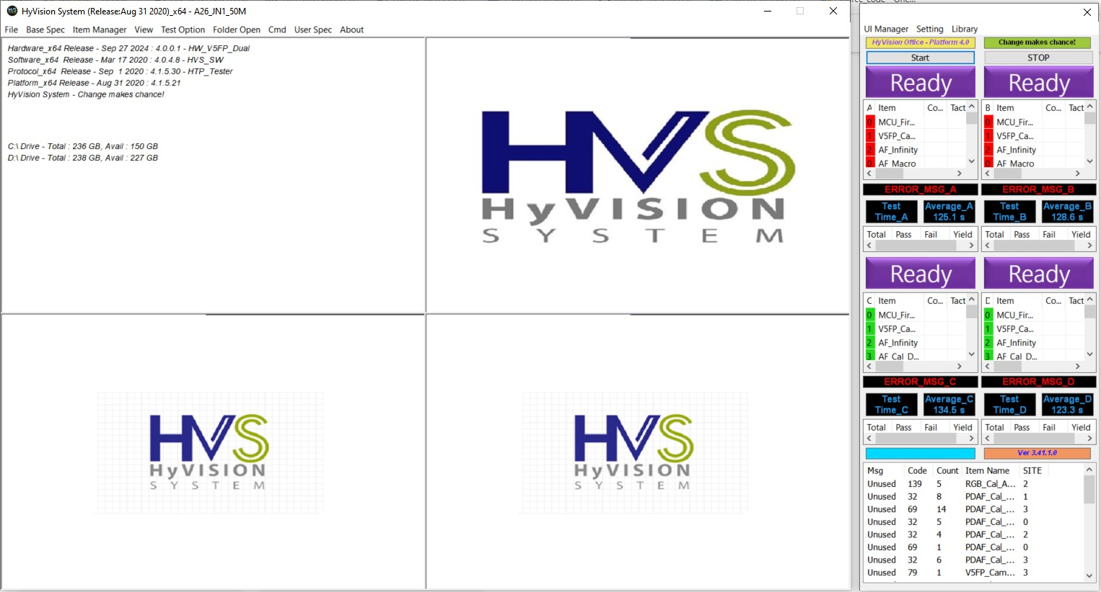
SCREEN TEST MACHINE

Slide 4
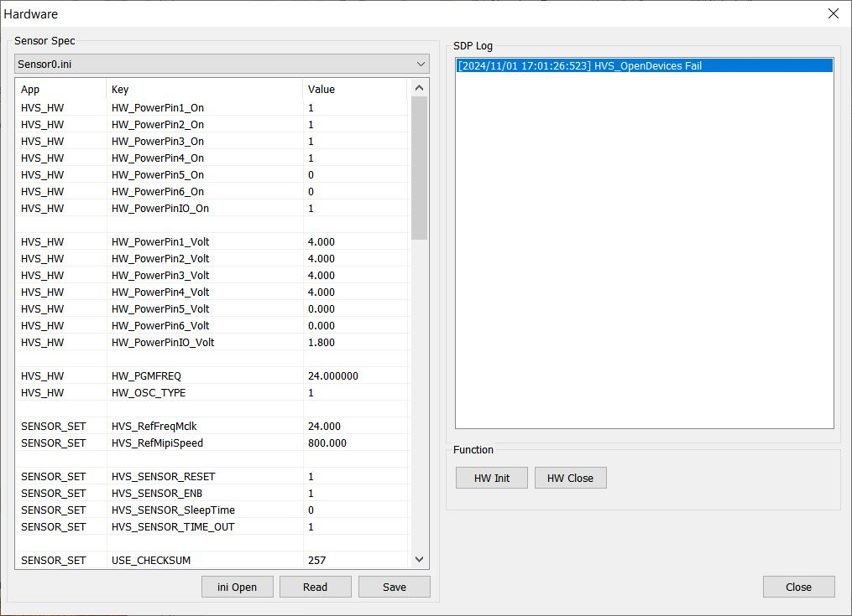
VIDEO & POWER CONFIG

Slide 5
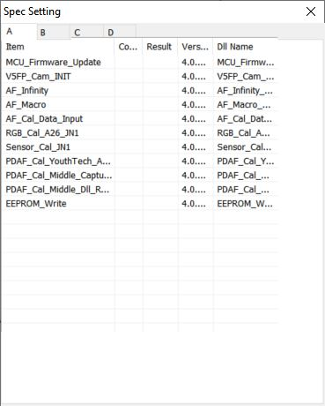
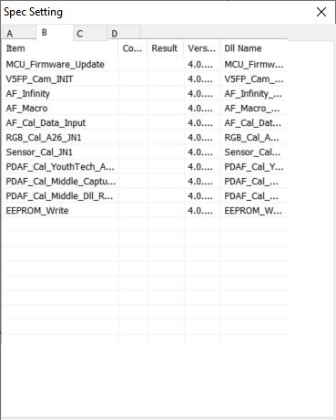
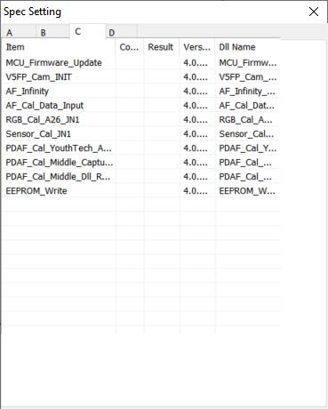
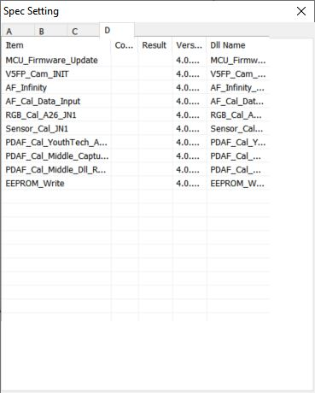
SPEC SETTING ALL SITE

Slide 6
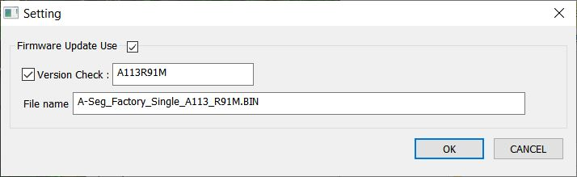
MCU_FIRMWARE_UPDATE_0

Slide 7
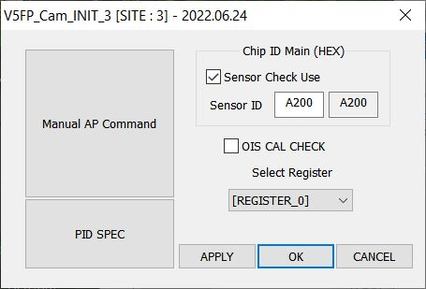
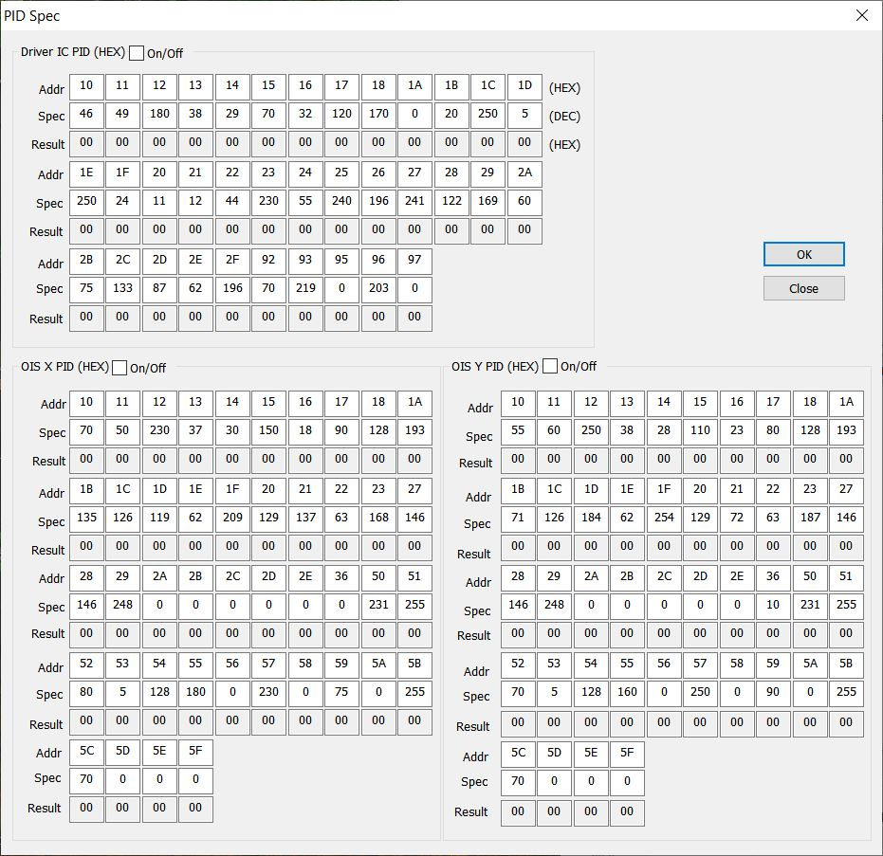
V5FP_CAM_INIT_0

Slide 8
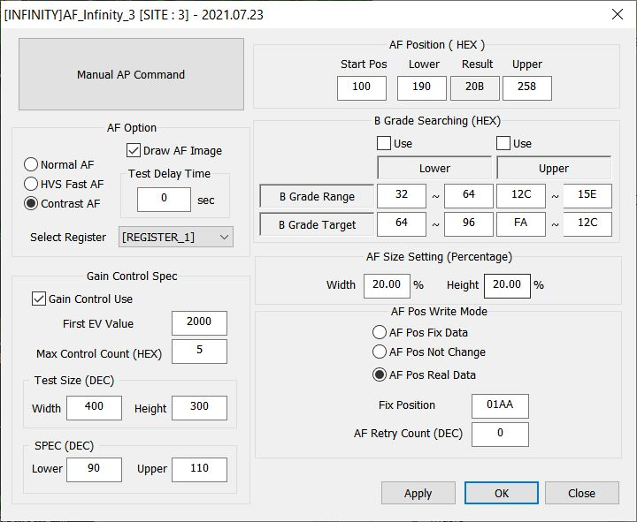
AF_INFINITY_0

Slide 9
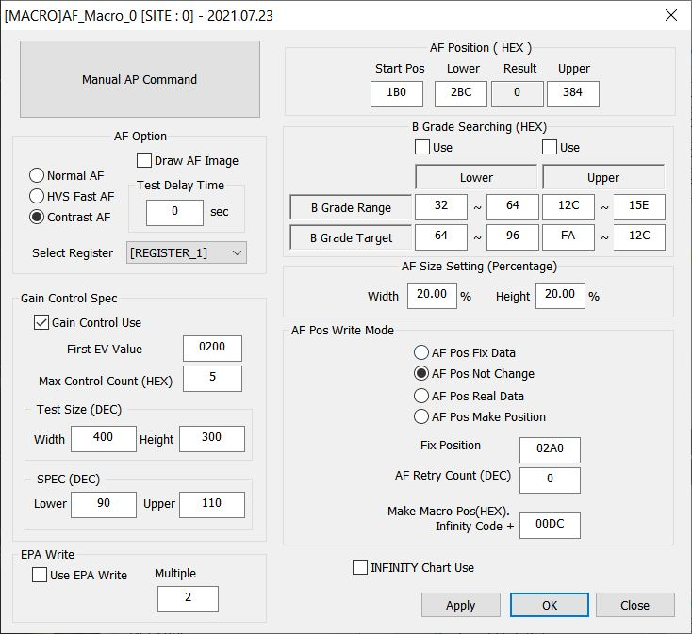
AF_MACRO_0

Slide 10
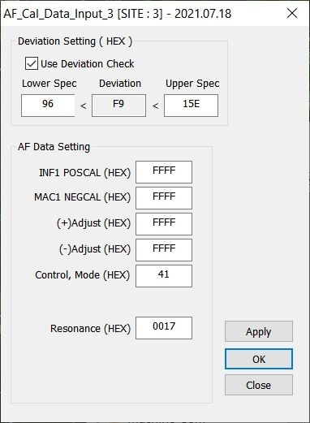
AF_CAL_DATA_INPUT_0

Slide 11
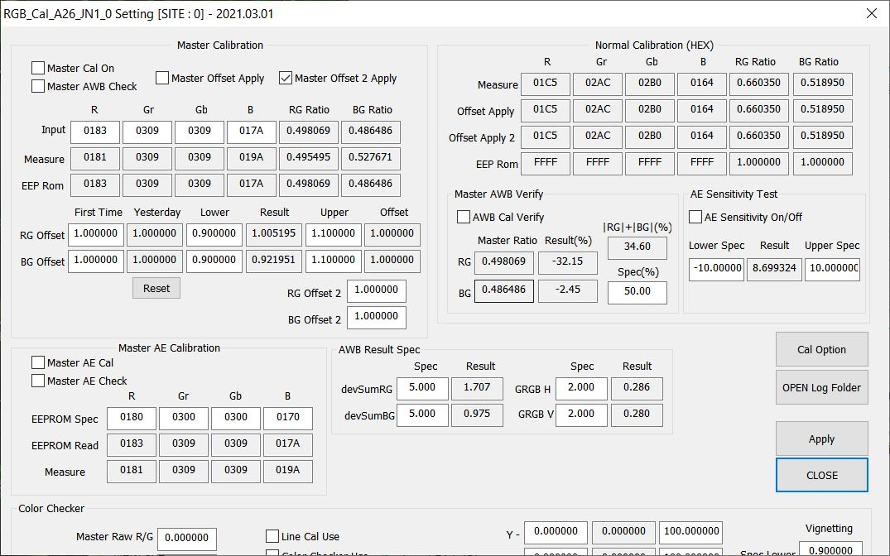
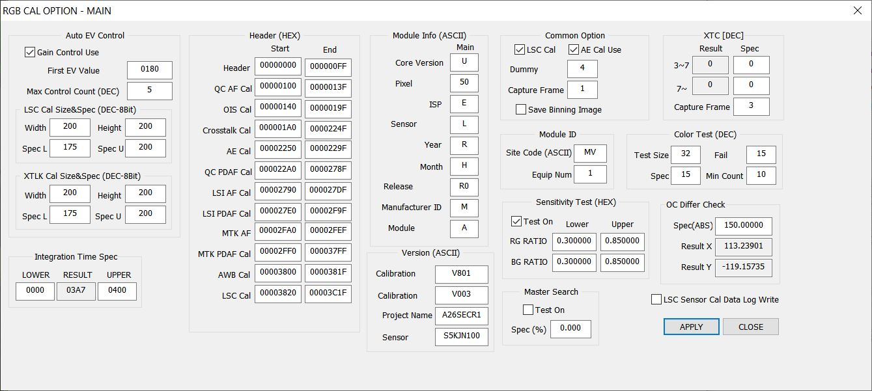
RGB_CAL_A26_JN1_0

Slide 12
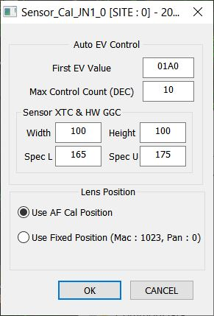
SENSOR_CAL_JN1_0

Slide 13
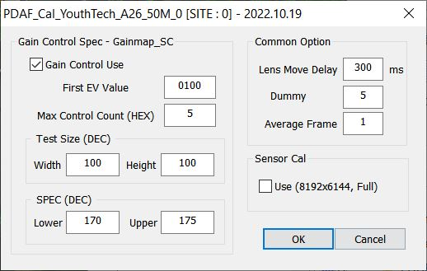
PDAF_CAL_YOUTHTECH_A26_50M_0

Slide 14
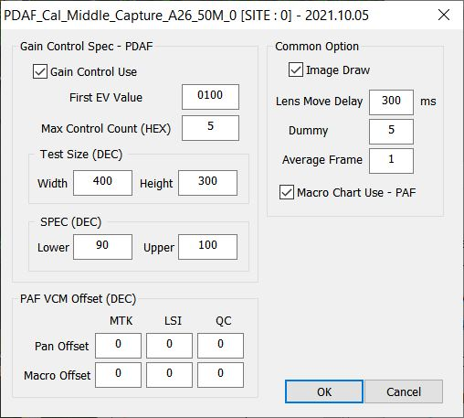
PDAF_CAL_MIDDLE_CAPTURE_A26_50M_0

Slide 15
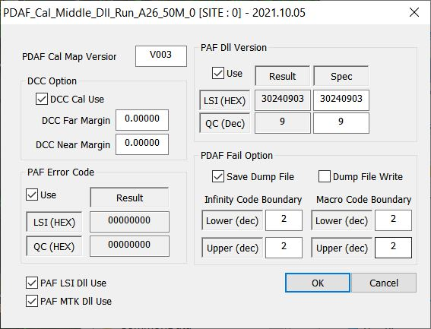
PDAF_CAL_MIDDLE_DLL_RUN_A26_50M_0

Slide 16
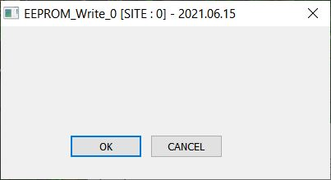
EEPROM_WRITE_0

Slide 17
A26 (Single) - 50M
Process PDAF(MAC)

Slide 18
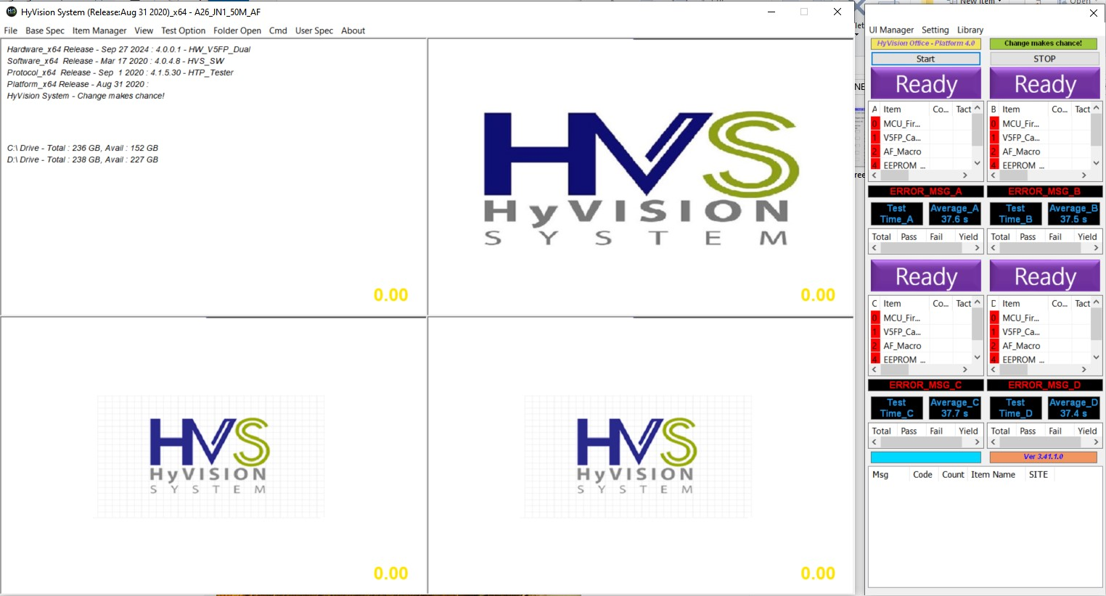
SCREEN TEST MACHINE

Slide 19
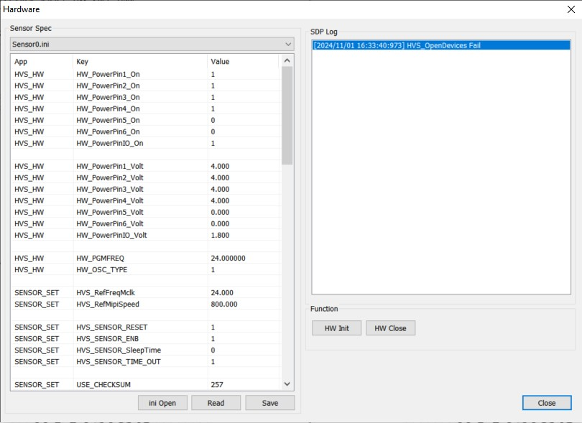
VIDEO & POWER CONFIG

Slide 20
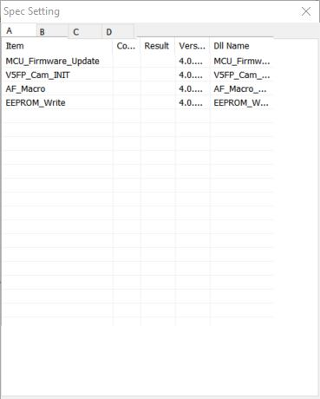
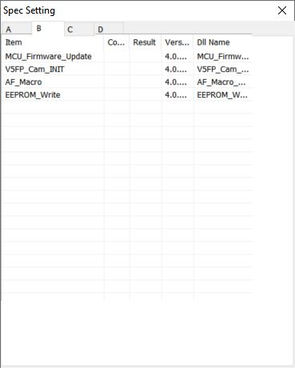
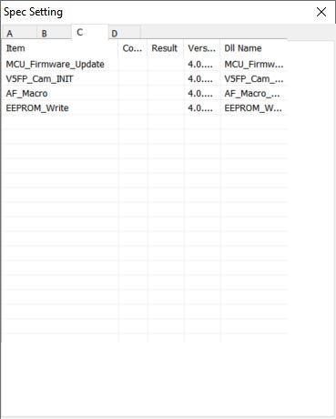
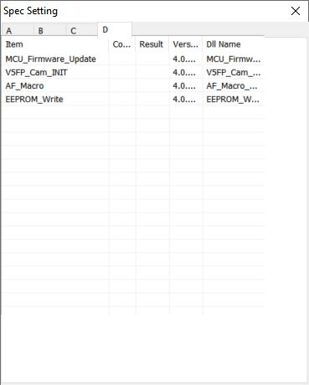
SPEC SETTING ALL SITE

Slide 21
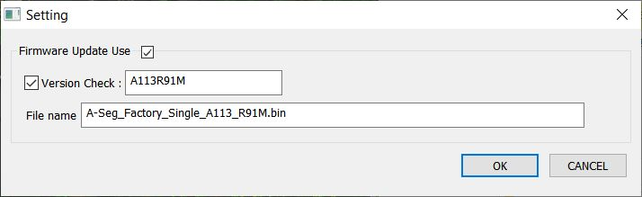
MCU_FIRMWARE_UPDATE_0

Slide 22


V5FP_CAM_INIT_0

Slide 23

AF_MACRO_0

Slide 24

EEPROM_WRITE_0

Slide 25
A26 (Single) - 50M
Process DF

Slide 26
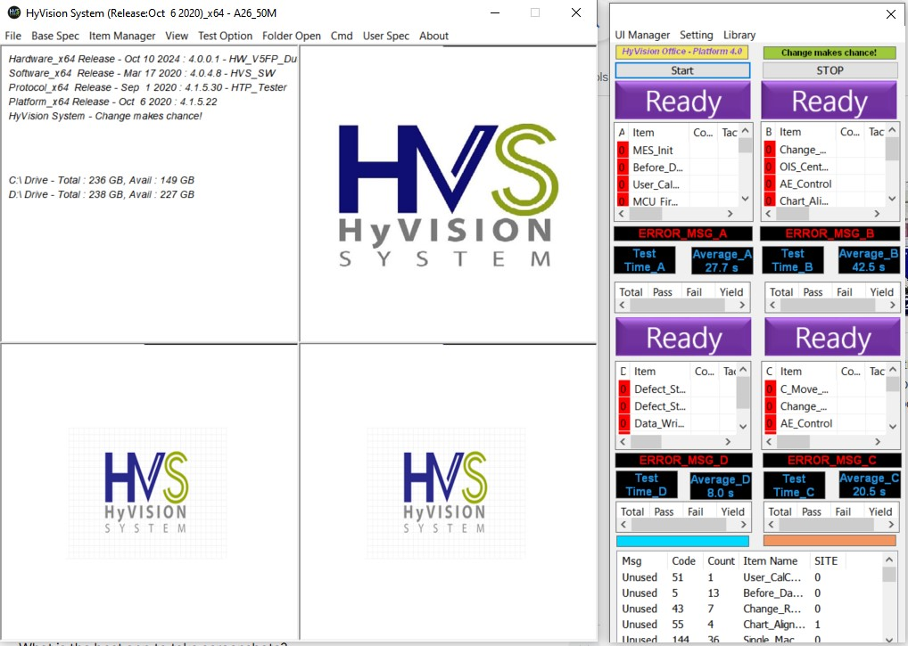
SCREEN TEST MACHINE

Slide 27

VIDEO & POWER CONFIG

Slide 28
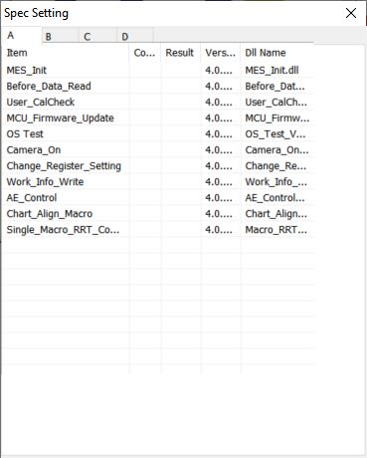
SPEC SPEC SETTING OF SITE A

Slide 29
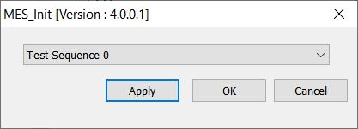
MES_INIT

Slide 30
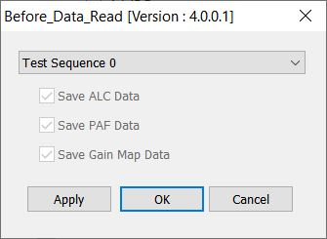
BEFORE_DATA_READ

Slide 31
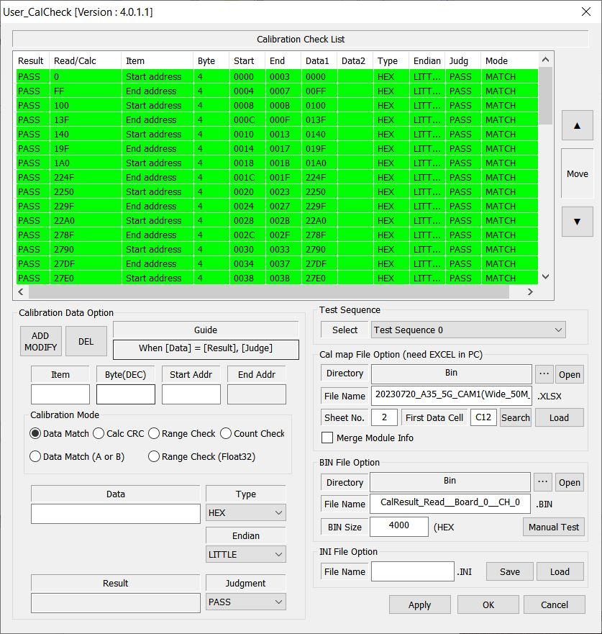
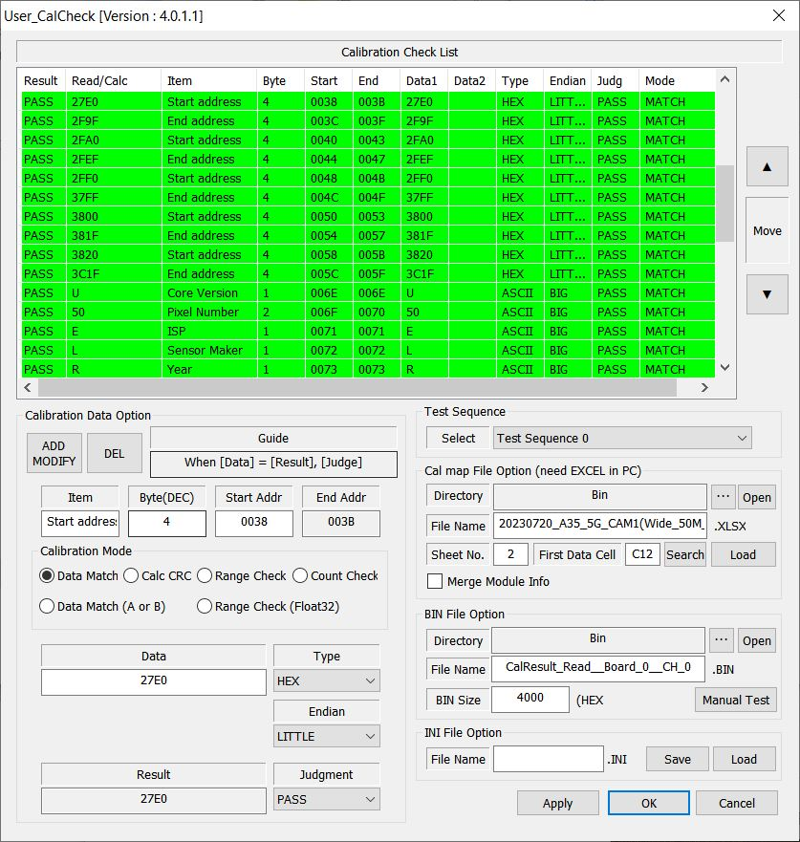
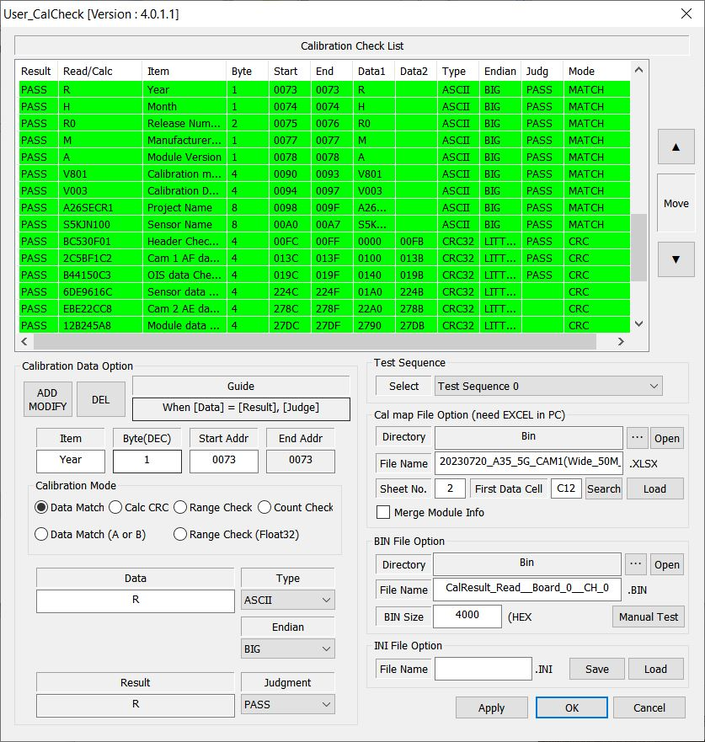
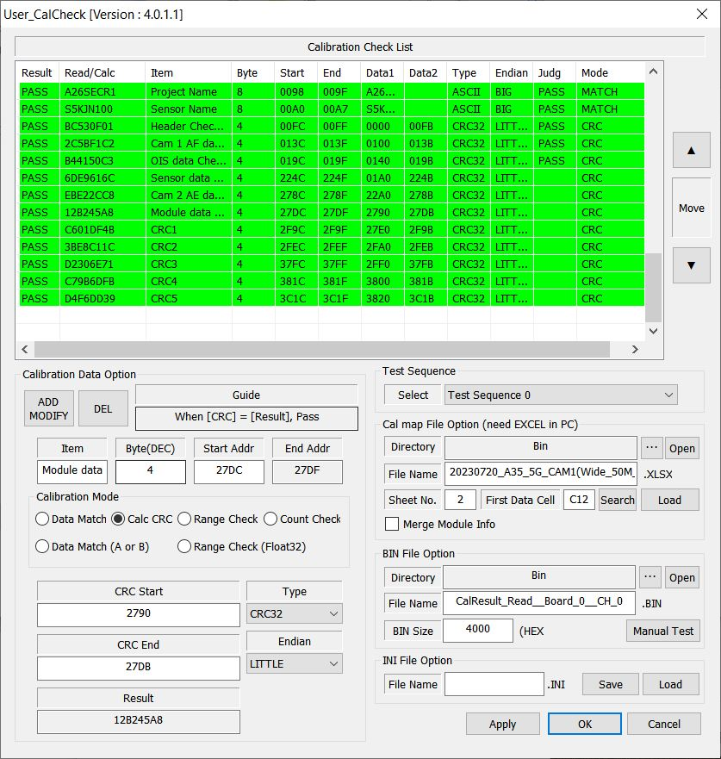
USER_CALCHECK

Slide 32
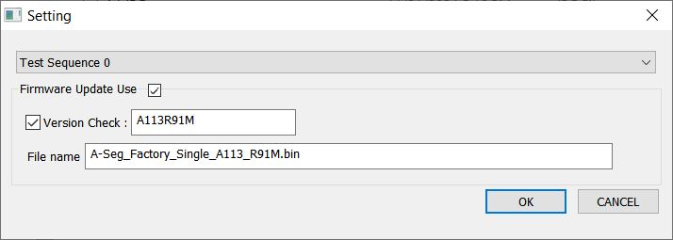
MCU_FIRMWARE_UPDATE

Slide 33
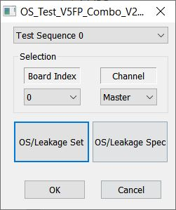
OS_TEST_V5FP_COMBO_V2

Slide 34
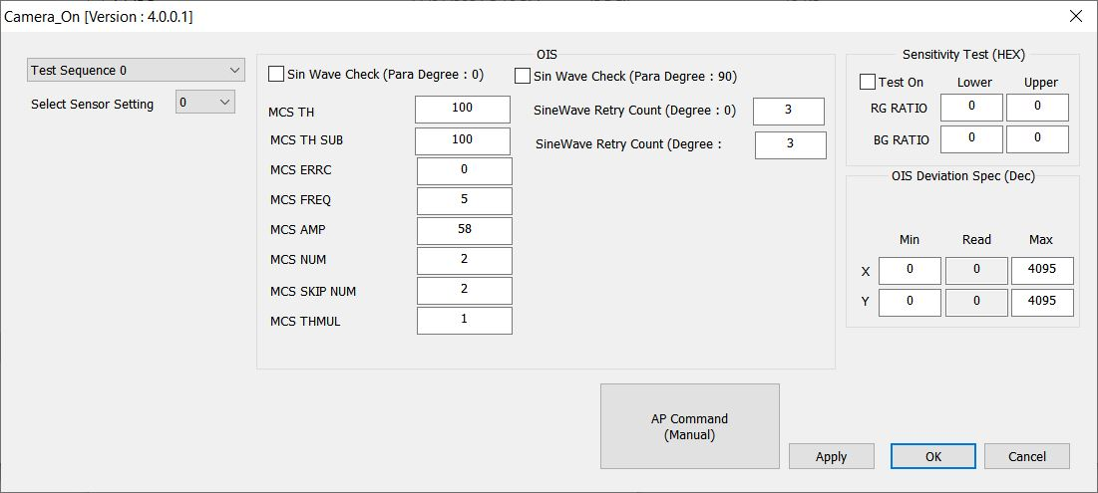
CAMERA_ON

Slide 35
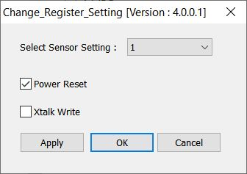
CHANGE_REGISTER_SETTING

Slide 36
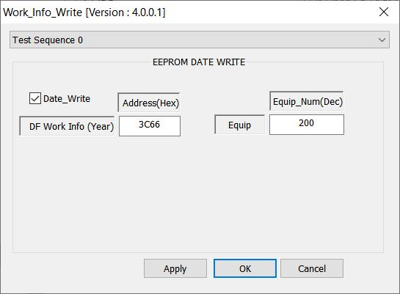
WORK_INFO_WRITE

Slide 37
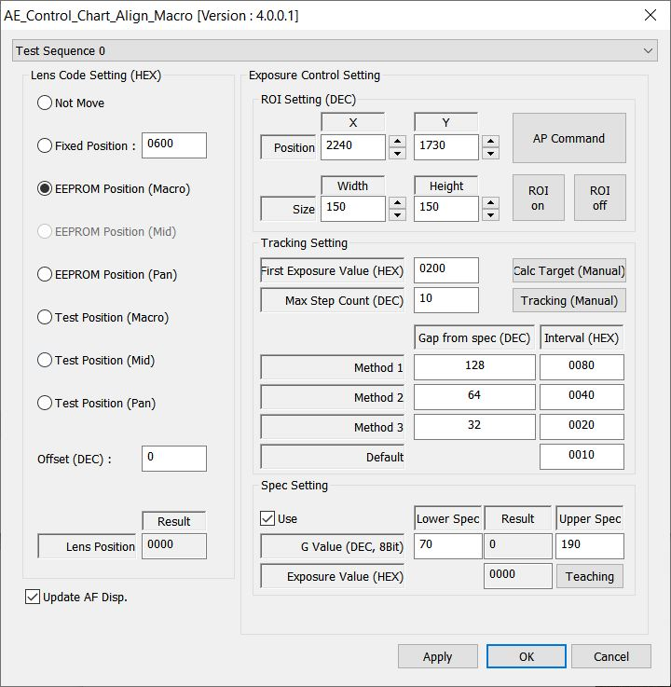
AE_CONTROL_CHART_ALIGN_MACRO

Slide 38
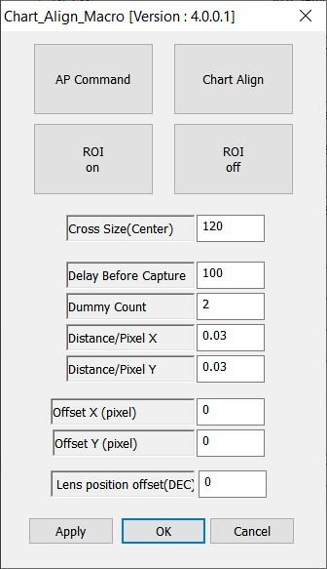
CHART_ALIGN_MACRO

Slide 39
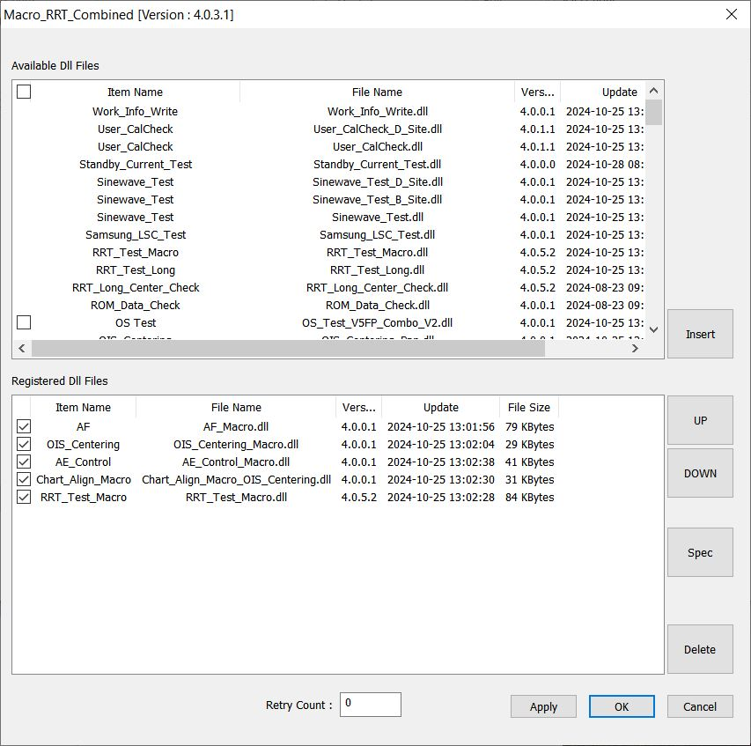
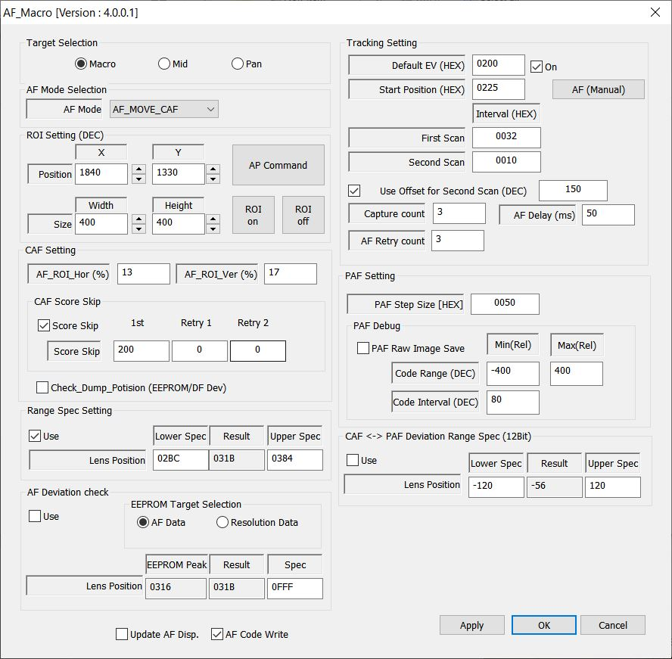
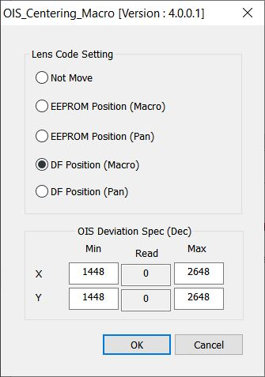
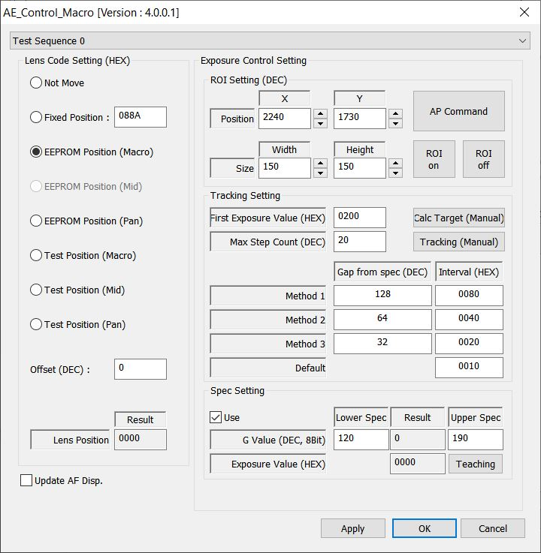
MACRO_RRT_COMBINED

Slide 40
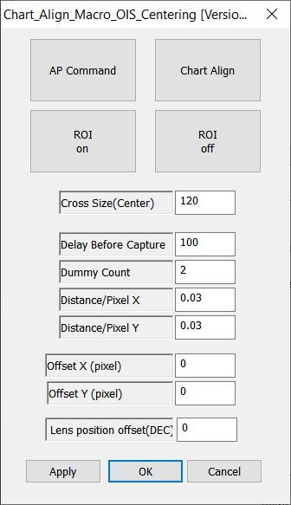
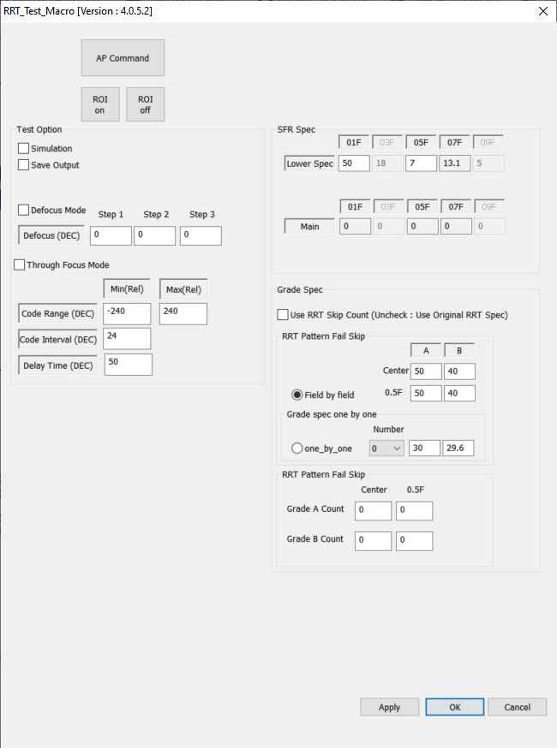
MACRO_RRT_COMBINED (SUB1)

Slide 41
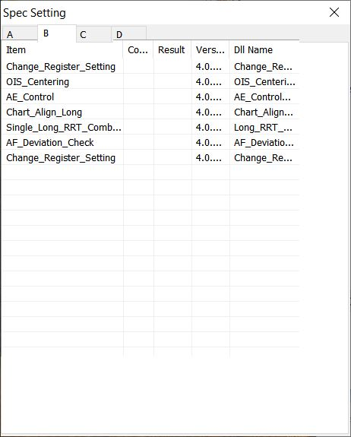
SPEC SPEC SETTING OF SITE B

Slide 42
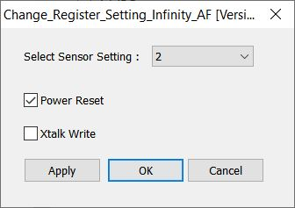
CHANGE_REGISTER_SETTING_INFINITY_AF

Slide 43
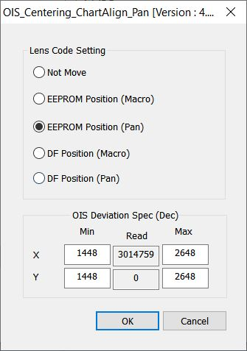
OIS_CENTERING_CHARTALIGN_PAN

Slide 44

AE_CONTROL_CHART_ALIGN_PAN

Slide 45

CHART_ALIGN_LONG

Slide 46




LONG_RRT_COMBINED

Slide 47


LONG_RRT_COMBINED (SUB1)

Slide 48

AF_DEVIATION_CHECK

Slide 49

CHANGE_REGISTER_SETTING

Slide 50

SPEC SPEC SETTING OF SITE C

Slide 51

C_MOVE_AVIS

Slide 52

CHANGE_AVIS_CHANNEL

Slide 53

AE_CONTROL_LSC

Slide 54

OIS_CENTERING_LSC

Slide 55

AE_CONTROL

Slide 56

AWB_VERIFICATION

Slide 57

IMAGE_CAPTURE

Slide 58

EXECUTE_SAMSUNG_OPTICAL_CENTER

Slide 59

EXECUTE_COLORCHECKER_SEC

Slide 60

SAMSUNG_LSC_TEST

Slide 61

CHANGE_AVIS_CHANNEL_LOWLIGHT

Slide 62

C_MOVE_YOUTHTECH

Slide 63

GAIN_CHANGE

Slide 64

GAIN_CHANGE_DARK

Slide 65

IMAGE_CAPTURE_LOWLIGHT

Slide 66


FIXED_PATTERN_NOISE_TEST_LOWLIGHT

Slide 67

EXECUTE_SAMSUNG_LOWLIGHT_INSPECTION_LOWLIGHT

Slide 68

C_MOVE_DARK

Slide 69

IMAGE_CAPTURE_DARK

Slide 70

EXECUTE_SAMSUNG_LOWLIGHT_INSPECTION_DARK

Slide 71

SPEC SPEC SETTING OF SITE D

Slide 72



DEFECT_STAIN_TEST_LSI

Slide 73


DEFECT_STAIN_TEST_LSI_WHITE_STAIN

Slide 74

DATA_WRITE_A26_50M

Slide 75




USER_CALCHECK_D_SITE

Slide 76
MODULE A26 SINGLE - 50M
THE END
THANKS FOR WATCHING!

